Slide 1
15CSE202 Object Oriented Programming
Lecture 16
Multithreading in Java
Nalinadevi Kadiresan
CSE Dept.
Amrita School of Engg.

Slide 2
Roadmap
Process concept
Thread concept
Thread Scheduling
Thread States
Creating Threads
Thread Synchronization
Pausing threads
Sept 2019
Nalinadevi Kadiresan

Slide 3
What is a process?
Code, data, and stack
  Usually (but not always) has its own address space (An address space is a range of valid addresses in memory that are available for a program or process.)
Program state
  CPU registers
  Program counter (current location in the code)
  Stack pointer
Only one process can be running in the CPU at any given time!
Sept 2019
Nalinadevi Kadiresan

Slide 4
The process model
Single PC
(CPU’s point of view)
Multiple PCs
(process point of view)
Multiprogramming of four programs
Conceptual model
  4 independent processes
  Processes run sequentially
Only one program active at any instant!
  That instant can be very short…
A
B
A
B
C
D
C
B
D
D
C
B
A
Time
Sept 2019
Nalinadevi Kadiresan

Slide 5
Process Creation
Parent process creates children processes, which, in turn create other processes, forming a tree of processes
Generally, process identified and managed via a process identifier (pid)
Resource sharing options
  Parent and children share all resources
  Children share subset of parent’s resources
  Parent and child share no resources
Execution options
  Parent and children execute concurrently
  Parent waits until children terminate
Sept 2019
Nalinadevi Kadiresan

Slide 6
When do processes end?
Conditions that terminate processes can be
  Voluntary
  Involuntary
Voluntary
  Normal exit
  Error exit
Involuntary
  Fatal error (only sort of involuntary)
  Killed by another process
Sept 2019
Nalinadevi Kadiresan

Slide 7
Processes in the OS
Two “layers” for processes
Lowest layer of process-structured OS handles interrupts, scheduling
Above that layer are sequential processes
  Processes tracked in the process table or
    This data structure is named as Process Control Block (not in scope of this course)
  Each process has a process table entry
Processes
0
1
…
N-2
N-1
Scheduler
Sept 2019
Nalinadevi Kadiresan

Slide 8
Roadmap
Process concept
Thread concept
Thread scheduling
Thread States
Creating Threads
Thread Synchronization
Pausing threads
Sept 2019
Nalinadevi Kadiresan

Slide 9
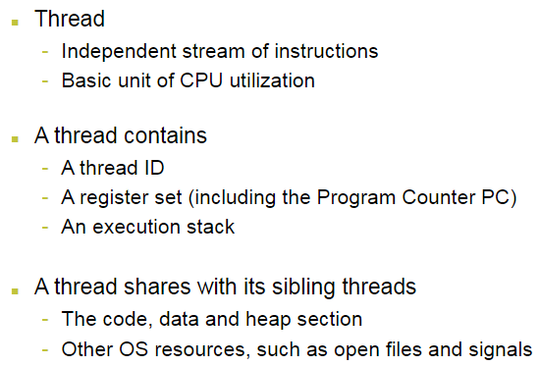
What is a Thread?
Data structure for thread is called as Thread Control Block
Sept 2019
Nalinadevi Kadiresan

Slide 10

Threads Concept
Multiple threads on multiple CPUs
Multiple threads sharing a single CPU
Sept 2019
Nalinadevi Kadiresan

Slide 11
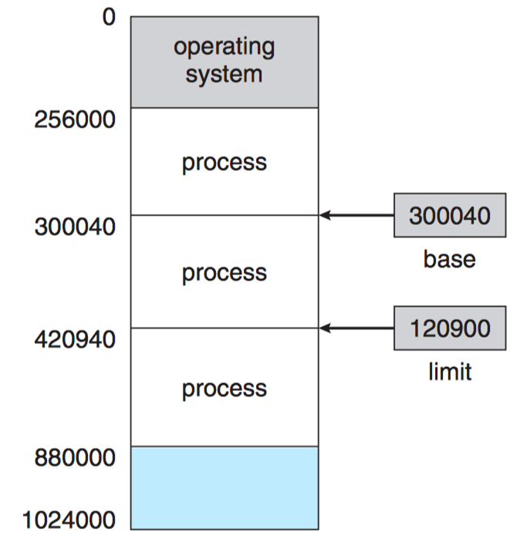
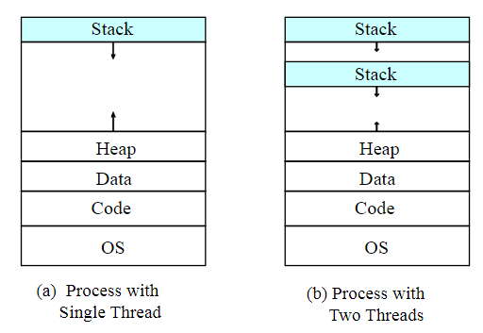
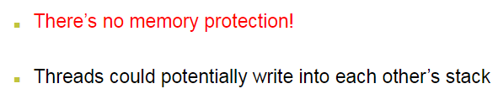
Process and Thread Address space
Sept 2019
Nalinadevi Kadiresan

Slide 12

Why use threads?
Allow a single application to do many things at once
  Simpler programming model
  Less waiting
Threads are faster to create or destroy
  No separate address space
Overlap computation and I/O
  Could be done without threads, but it’s harder
Example: word processor
  Thread to read from keyboard
  Thread to format document
  Thread to write to disk
When in the Course of human events, it becomes necessary for one people to dissolve the political bands which have connected them with another, and to assume among the powers of the earth, the separate and equal station to which the Laws of Nature and of Nature's God entitle them, a decent respect to the opinions of mankind requires that they should declare the causes which impel them to the separation.
We hold these truths to be self-evident, that all men are created equal, that they are endowed by their Creator with certain unalienable Rights, that among these are Life, Liberty and the pursuit of Happiness.--That to secure these rights, Governments are instituted among Men, deriving their just powers from the consent of the governed, --That whenever any Form of Government becomes
destructive of these ends, it is the Right of the People to alter or to abolish it, and to institute new Government, laying its foundation on such principles and organizing its powers in such form, as to them shall seem most likely to effect their Safety and Happiness. Prudence, indeed, will dictate that Governments long established should not be changed for light and transient causes; and accordingly all
Kernel
Sept 2019
Nalinadevi Kadiresan

Slide 13
Implementing threads
Process
Thread
Kernel
Kernel
Run-time
system
Thread
table
Process
table
Process
table
Thread
table
User-level threads
+ No need for kernel support
- May be slower than kernel threads
Harder to do non-blocking I/O
Kernel-level threads
+ More flexible scheduling
+ Non-blocking I/O
Not portable
Sept 2019
Nalinadevi Kadiresan

Slide 14
Roadmap
Process concept
Thread concept
Thread scheduling
Thread States
Creating Threads
Thread Synchronization
Pausing threads
Sept 2019
Nalinadevi Kadiresan

Slide 15
Scheduling Mechanism
  Mechanism allows
    Priorities to be assigned to processes
    CPU to select processes with high priorities
  Policy set by what priorities are assigned to processes
Sept 2019
Nalinadevi Kadiresan

Slide 16
Scheduling user-level threads
Kernel picks a process to run next
Run-time system (at user level) schedules threads
  Run each thread for less than process quantum
  Example: processes get 40ms each, threads get 10ms each
Example schedule:
A1,A2,A3,A1,B1,B3,B2,B3
Not possible:
A1,A2,B1,B2,A3,B3,A2,B1
Process A
Process B
Kernel
Run-time
system
Thread
table
Process
table
These are the threads that application programmers would put into their programs.
Sept 2019
Nalinadevi Kadiresan

Slide 17
Scheduling kernel-level threads
Process A
Process B
Kernel schedules each thread
  No restrictions on ordering
  May be more difficult for each process to specify priorities
Example schedule:
A1,A2,A3,A1,B1,B3,B2,B3
Also possible:
A1,A2,B1,B2,A3,B3,A2,B1
Kernel
Process
table
Thread
table
Kernel-level threads are supported within the kernel of the OS itself
Sept 2019
Nalinadevi Kadiresan

Slide 18
Thread Scheduler in Java
Thread scheduler in java is the part of the JVM that decides which thread should run.
There is no guarantee that which runnable thread will be chosen to run by the thread scheduler.
Only one thread at a time can run in a single process.
Preemptive scheduling vs time slicing
  Preemptive scheduling, the highest priority task executes until it enters the waiting or dead states or a higher priority task comes into existence.
  Time slicing, a task executes for a predefined slice of time and then reenters the pool of ready tasks. The scheduler then determines which task should execute next, based on priority and other factors.
Sept 2019
Nalinadevi Kadiresan

Slide 19
Priority for Threads in Java
Each thread have a priority.
Priorities are represented by a number between 1 and 10.
3 constants defined in Thread class:
  public static int MIN_PRIORITY
  public static int NORM_PRIORITY
  public static int MAX_PRIORITY
Default priority of a thread is 5 (NORM_PRIORITY).
The value of MIN_PRIORITY is 1 and
the value of MAX_PRIORITY is 10.
Let us start with NORM_PRIORITY for all threads !!
Sept 2019
Nalinadevi Kadiresan

Slide 20
Roadmap
Process concept
Thread concept
Thread scheduling
Thread States
Creating Threads
Thread Synchronization
Pausing threads
Sept 2019
Nalinadevi Kadiresan

Slide 21
States of Java Threads
4 separate states
  new: just created but not started
  runnable: created, started, and able to run
  blocked: created and started but unable to run because it is waiting for some event to occur
  dead: thread has finished or been stopped
Sept 2019
Nalinadevi Kadiresan

Slide 22
States of Java Threads
stop(),
end of run method
start()
runnable
new
dead
wait(),
I/O request,
suspend()
notify(),
I/O completion,
resume()
blocked
Sept 2019
Nalinadevi Kadiresan

Slide 23
Portability issues (JVM)
Portability
  Differences between platforms (e.g., Solaris, Windows, …)
On Solaris (Linux?)
  A thread runs to completion or until a higher priority thread becomes ready
  Preemption occurs (processor is given to the higher-priority thread)
On Win32 (Windows 9x, NT, XP)
  Threads are timesliced
    Thread given quantum of time to execute
    Processor then switched to any threads of equal priority
  Preemption occurs with higher and equal priority threads
Sept 2019
Nalinadevi Kadiresan

Slide 24
Programming challenges
For application programmers, there are five areas where multi-core chips present new challenges:
Identifying tasks - Examining applications to find activities that can be performed concurrently.
Balance - Finding tasks to run concurrently that provide equal value. I.e. don't waste a thread on trivial tasks.
Data splitting - To prevent the threads from interfering with one another.
Data dependency - If one task is dependent upon the results of another, then the tasks need to be synchronized to assure access in the proper order.
Testing and debugging - Inherently more difficult in parallel processing situations, as the race conditions become much more complex and difficult to identify.
Sept 2019
Nalinadevi Kadiresan

Slide 25
Roadmap
Process concept
Thread concept
Thread scheduling
Thread States
Creating Threads
Thread Synchronization
Pausing threads
Sept 2019
Nalinadevi Kadiresan

Slide 26
Creating Java Threads
Java threads are user-level threads which connects to JVM kernel-level threads, that is, pthreads in UNIX or Win32 threads in windows.
Two ways to create a thread
  Option 1: Extend the Thread class and override the public run method
  Option 2: Implement a runnable interface with a public run method
Sept 2019
Nalinadevi Kadiresan

Slide 27
Threads in Java
The operation we want to be threaded:
public class PrintNumbers {
public void printNumbers() {
for(int i=0; i<10; i++) {
System.out.println(
Thread.currentThread().getId() +
": " + i);
}
}
}
Sept 2019
Nalinadevi Kadiresan

Slide 28
Threads in Java
Option 1 – extending class Thread:
public class PrintNumbers extends Thread{
public void printNumbers() {
for(int i=0; i<9; i++) {
System.out.println( Thread.currentThread().getId()+ ": " + i); }
}
@Override
public void run() {
printNumbers();
// the super doesn't anything,
// but just for the courtesy and good practice
super.run();
}
}
Sept 2019
Nalinadevi Kadiresan

Slide 29
Threads in Java
Option 1 – extending class Thread (cont’):
public class TestDriver {
public static void main(String[] args) {
System.out.println("Main ThreadId: " + Thread.currentThread().getId());
for(int i=0; i<3; i++) {
new PrintNumbers().start(); // don't call run! // (if you want a separate thread)
}
}
}
Sept 2019
Nalinadevi Kadiresan

Slide 30
Output
Main ThreadId: 1
11: 0
11: 1
11: 2
12: 0
12: 1
12: 2
12: 3
12: 4
12: 5
12: 6
12: 7
12: 8
Random Pattern of Time Slicing
11: 3
11: 4
11: 5
10: 0
10: 1
10: 2
10: 3
10: 4
10: 5
10: 6
10: 7
10: 8
11: 6
11: 7
11: 8
Sept 2019
Nalinadevi Kadiresan

Slide 31
An Overview of the Thread Methods
Thread-related methods
  See API for more details (especially exceptions)
  Constructors
    Thread() - Creates a thread with an auto-numbered name of format Thread-1, Thread-2...
    Thread( threadName ) - Creates a thread with name
  run
    Does “work” of a thread – What does this mean?
    Can be overridden in subclass of Thread or in Runnable object (more on interface Runnable elsewhere)
  start
    Launches thread, then returns to caller
    Calls run
    Error to call start twice for same thread
Sept 2019
Nalinadevi Kadiresan

Slide 32
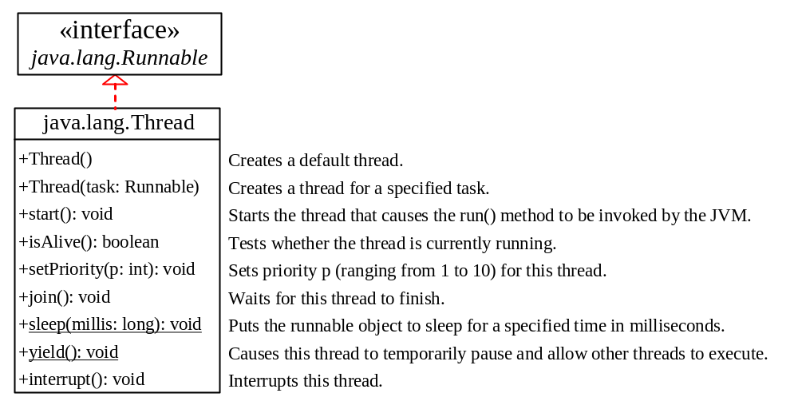
The Thread Class
Sept 2019
Nalinadevi Kadiresan

Slide 33
Threads in Java
Option 2 – implementing Runnable:
public class PrintNumbers implements Runnable{
public void printNumbers() {
for(int i=0; i<9; i++) {
System.out.println( Thread.currentThread().getId()+ ": " + i); }
}
@Override
public void run() {
printNumbers();
}
}
Sept 2019
Nalinadevi Kadiresan

Slide 34
Threads in Java
Option 2 – implementing Runnable(cont’):
public class TestDriver {
public static void main(String[] args) {
System.out.println("Main ThreadId: " + Thread.currentThread().getId());
for(int i=0; i<3; i++) {
new Thread(new PrintNumbers()).start();
}
}
}
Sept 2019
Nalinadevi Kadiresan

Slide 35
Output
Main ThreadId: 1
11: 0
11: 1
11: 2
12: 0
12: 1
12: 2
12: 3
12: 4
12: 5
12: 6
12: 7
12: 8
Random Pattern of Time Slicing
11: 3
11: 4
11: 5
10: 0
10: 1
10: 2
10: 3
10: 4
10: 5
10: 6
10: 7
10: 8
11: 6
11: 7
11: 8
Sept 2019
Nalinadevi Kadiresan

Slide 36
Advantage of Using Runnable
remember - can only extend one class
implementing runnable allows class to extend something else
Sept 2019
Nalinadevi Kadiresan

Slide 37
Example 2
public class SingleCounter extends Thread{
private int c = 0;
public void increment() {
System.out.println(Thread.currentThread().getId()+" incrementing...");
c++;
System.out.println(Thread.currentThread().getId()+" incremented...");
}
public void decrement() {
System.out.println(Thread.currentThread().getId()+" decrementing...");
c++;
System.out.println(Thread.currentThread().getId()+" decremented...");
}
public int getVal() {
return c;
}
}
Sept 2019
Nalinadevi Kadiresan

Slide 38
Example 2
public class TestDriver {
  public static void main(String[] args)
  {
  SingleCounter counter1 = new SingleCounter();
  Thread t1 =new Thread(counter1);
  Thread t2 = new Thread(counter1);
  t1.start();
  t2.start();
  }
}
Sept 2019
Nalinadevi Kadiresan

Slide 39
Output:
12 incrementing...
13 incrementing...
12 incremented...
13 incremented...
13after increment:2
13 decrementing...
12after increment:2
12 decrementing...
13 decremented...
12 decremented...
13after decrement:0
12after decrement:0
Atomic operations are split
Problem: Task 1 and Task 2 are accessing a common resource (memory of the variable c) in a way that causes conflict.
Known as a race condition in multithreaded programs.
A thread-safe class does not cause a race condition in the presence of multiple threads.
Sept 2019
Nalinadevi Kadiresan

Slide 40
Roadmap
Process concept
Thread concept
Thread scheduling
Thread States
Creating Threads
Thread Synchronization
Pausing threads
Sept 2019
Nalinadevi Kadiresan

Slide 41
Thread Synchronization
To clarify thread synchronization, consider the following example for race condition:
  three threads - A, B, and C - are executed concurrently and need to access a critical resource, Z.
  To avoid conflicts when accessing Z, threads A, B, and C must be synchronized.
  Thus, when A accesses Z, and B also tries to access Z, B’s access of Z must be avoided with security measures until A finishes its operation and comes out of Z.
Sept 2019
Nalinadevi Kadiresan

Slide 42
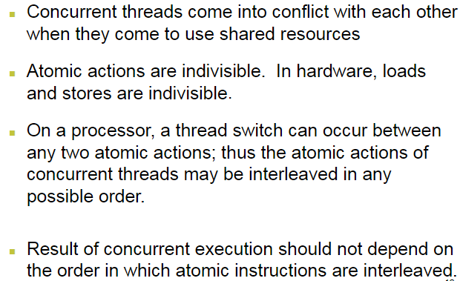
Sharing Resources in Concurrent Threads
Sept 2019
Nalinadevi Kadiresan

Slide 43
Thread Synchronization in Java
For achieving synchronization in Java concept of monitor is used.
Every object created in Java has one associated monitor (mutually exclusive lock).
At any given time Only one thread can own the monitor.
In Java, two synchronization strategies are used to prevent thread interference and memory consistency errors:
  Synchronized Method
  Synchronized Statement
Sept 2019
Nalinadevi Kadiresan

Slide 44
Synchronizing Methods
Syntax:
synchronized <returntype> method_name(parameter_list){ …. }
A thread invoking a synchronized method automatically acquires the intrinsic lock for that method's object and releases it when the method returns.
we can have four different ways synchronized keyword in Java can be used.
  instance method
  An enclosed code block with in an instance method (Synchronized block).
  static method
  An enclosed code block with in a static method.
Sept 2019
Nalinadevi Kadiresan

Slide 45
Example 1 – synchronizing methods
public class PrintNumbers extends Thread{
public synchronized void printNumbers() {
for(int i=0; i<9; i++) {
System.out.println( Thread.currentThread().getId()+ ": " + i); }
}
@Override
public void run() {
printNumbers();
// the super doesn't anything,
// but just for the courtesy and good practice
super.run();
}
}
Sept 2019
Nalinadevi Kadiresan

Slide 46
Output
Main ThreadId: 1
11: 0
11: 1
11: 2
11: 3
11: 4
11: 5
11: 6
11: 7
11: 8
10: 0
10: 1
10: 2
10: 3
10: 4
10: 5
10: 6
10: 7
10: 8
12: 0
12: 1
12: 2
12: 3
12: 4
12: 5
12: 6
12: 7
12: 8
Sept 2019
Nalinadevi Kadiresan

Slide 47
Example 2 – synchronizing methods
public class SynchronizedSingleCounter implements Runnable{
private int c = 0;
public synchronized void increment() {
System.out.println(Thread.currentThread().getId()+" incrementing...");
c++;
System.out.println(Thread.currentThread().getId()+" incremented...");
}
public synchronized void decrement() {
System.out.println(Thread.currentThread().getId()+" decrementing...");
c++;
System.out.println(Thread.currentThread().getId()+" decremented...");
}
Sept 2019
Nalinadevi Kadiresan

Slide 48
Example 2 – synchronizing methods
public synchronized int getVal() {
return c;
}
public void run() {
increment();
System.out.println(Thread.currentThread().getId() + "after increment:" + getVal());
decrement();
System.out.println(Thread.currentThread().getId() + "after decrement:"+ getVal());
}
}
Sept 2019
Nalinadevi Kadiresan

Slide 49
Example 2 – synchronizing methods (contd)
public class TestDriver {
  public static void main(String[] args)
  {
  SynchronizedSingleCounter counter1 = new
  SynchronizedSingleCounter();
  Thread t1 =new Thread(counter1);
  Thread t2 = new Thread(counter1);
  t1.start();
  t2.start();
  }
}
Sept 2019
Nalinadevi Kadiresan

Slide 50
Output:
10 incrementing...
10 incremented...
11 incrementing...
11 incremented...
11after increment:2
11 decrementing...
11 decremented...
11after decrement:1
10after increment:2
10 decrementing...
10 decremented...
10after decrement:0
Synchronized method
How about synchronizing a threads increment and decrement operation ?
Sept 2019
Nalinadevi Kadiresan

Slide 51
Synchronized Block
Declares a block of code to be synchronized.
Unlike synchronized methods, synchronized statements should specify the objects that provide the intrinsic lock.
These statements are useful for improving concurrency with fine-grained synchronization, as they enable the avoidance of unnecessary blocking.
Sept 2019
Nalinadevi Kadiresan

Slide 52
Example 1 – synchronizing blocks
public class SynchronizedSingleCounter implements Runnable{
private int c = 0;
public synchronized void increment() {
System.out.println(Thread.currentThread().getId()+" incrementing...");
c++;
System.out.println(Thread.currentThread().getId()+" incremented...");
}
public synchronized void decrement() {
System.out.println(Thread.currentThread().getId()+" decrementing...");
c++;
System.out.println(Thread.currentThread().getId()+" decremented...");
}
Sept 2019
Nalinadevi Kadiresan

Slide 53
public synchronized int getVal() {
return c;
}
public void run() {
synchronized (this) {
increment();
System.out.println(Thread.currentThread().getId() + "after increment:" + getVal());
decrement();
System.out.println(Thread.currentThread().getId() + "after decrement:" + getVal());
}
}
}
Sept 2019
Nalinadevi Kadiresan

Slide 54
Example 1 – synchronizing blocks (contd)
public class TestDriver {
  public static void main(String[] args)
  {
  SynchronizedSingleCounter counter1 = new
  SynchronizedSingleCounter();
  Thread t1 =new Thread(counter1);
  Thread t2 = new Thread(counter1);
  t1.start();
  t2.start();
  }
}
Sept 2019
Nalinadevi Kadiresan

Slide 55
Output
10 incrementing...
10 incremented...
10after increment:1
10 decrementing...
10 decremented...
10after decrement:0
11 incrementing...
11 incremented...
11after increment:1
11 decrementing...
11 decremented...
11after decrement:0
Sept 2019
Nalinadevi Kadiresan

Slide 56
Example 2– synchronizing using different locks:
public class TwoCounters {
private long c1 = 0, c2 = 0;
private Object lock1 = new Object();
private Object lock2 = new Object();
public void inc1() {
synchronized(lock1) {
c1++;
}
}
public void inc2() {
synchronized(lock2) {
c2++;
}
}
}
You must be absolutely sure that there is no tie between c1 and c2
Advanced concepts like ReentrantLock is not in the scope of this course
Sept 2019
Nalinadevi Kadiresan

Slide 57
Synchronizing Static methods
Having a static method be synchronized means that ALL objects of this type are locked on the method and can get in one thread at a time.
The lock is the Class object representing this class.
The performance penalty might be sometimes too high – needs careful attention!
Sept 2019
Nalinadevi Kadiresan

Slide 58
Example 1 – synchronizing static methods:
public class Screen {
private static Screen theScreen;
private Screen(){…} // private c’tor
public static synchronized getScreen() {
if(theScreen == null) {
theScreen = new Screen();
}
return theScreen;
}
}
This is a Singleton example
It is not the most
efficient way to implement Singleton in Java
Sept 2019
Nalinadevi Kadiresan

Slide 59
Example 1: – a better singleton:
public class Screen {
private static Screen theScreen = new Screen();
private Screen(){…} // private c’tor
public static getScreen() {
return theScreen;
}
}
No synchronization
Avoid static method synchronization as much as possible !!!
Sept 2019
Nalinadevi Kadiresan

Slide 60
Example – Message display without synchronization
public class MessageThread implements Runnable{
  String message;
  public MessageThread(String msg)
  { message = msg; }
  public void displayMsg(){
  System.out.println("Inside displayMsg method " +
  Thread.currentThread().getName());
  System.out.println("**" + message+”*”);
  }
  public void run() { displayMsg(); }
}
Sept 2019
Nalinadevi Kadiresan

Slide 61
public class SynchronizedDemo {
public static void main(String[] args) {
MessageThread msg1 = new MessageThread("I");
MessageThread msg2 = new MessageThread("am");
MessageThread msg3 = new MessageThread("not");
MessageThread msg4 = new MessageThread("synchronized");
Thread t1 = new Thread(msg1);
Thread t2 = new Thread(msg2);
Thread t3 = new Thread(msg3);
Thread t4 = new Thread(msg4);
t1.start();t2.start();t3.start();t4.start();
}
}
Inside displayMsg method Thread-0
**I *
Inside displayMsg method Thread-1
**am *
Inside displayMsg method Thread-2
Inside displayMsg method Thread-3
**synchronized *
**not *
Let us Synchronize display !!!!
Sept 2019
Nalinadevi Kadiresan

Slide 62
Example – Message display with method synchronization
public class MessageThread implements Runnable{
  String message;
  public MessageThread(String msg)
  { message = msg; }
  public synchronized void displayMsg(){
  System.out.println("Inside displayMsg method " +
  Thread.currentThread().getName());
  System.out.println("**" + message+ “*”);
  }
  public void run() { displayMsg(); }
}
Sept 2019
Nalinadevi Kadiresan

Slide 63
public class SynchronizedDemo {
public static void main(String[] args) {
MessageThread msg1 = new MessageThread("I");
MessageThread msg2 = new MessageThread("am");
MessageThread msg3 = new MessageThread("not");
MessageThread msg4 = new MessageThread("synchronized");
Thread t1 = new Thread(msg1);
Thread t2 = new Thread(msg2);
Thread t3 = new Thread(msg3);
Thread t4 = new Thread(msg4);
t1.start();t2.start();t3.start();t4.start();
}
}
Inside displayMsg method Thread-1
**am *
Inside displayMsg method Thread-0
**I *
Inside displayMsg method Thread-3
**synchronized *
Inside displayMsg method Thread-2
**not *
Synchronizing among message object not done
This needs prioritizing!!!!
Sept 2019
Nalinadevi Kadiresan

Slide 64
Setting priority for threads
public class SynchronizedDemo {
public static void main(String[] args) {
MessageThread msg1 = new MessageThread("I");
MessageThread msg2 = new MessageThread("am");
MessageThread msg3 = new MessageThread("not");
MessageThread msg4 = new MessageThread("synchronized");
Thread t1 = new Thread(msg1);
Thread t2 = new Thread(msg2);
Thread t3 = new Thread(msg3);
Thread t4 = new Thread(msg4);
t1.setPriority(Thread.MAX_PRIORITY);
t2.setPriority(Thread.MAX_PRIORITY-2);
t3.setPriority(Thread.MAX_PRIORITY-3);
t4.setPriority(Thread.MIN_PRIORITY);
t1.start();t2.start();t3.start();t4.start();
}
}
Inside displayMsg method Thread-0
**I *
Inside displayMsg method Thread-1
**am *
Inside displayMsg method Thread-2
**not *
Inside displayMsg method Thread-3
**synchronized *
Sept 2019
Nalinadevi Kadiresan

Slide 65
Roadmap
Process concept
Thread concept
Thread scheduling
Thread States
Creating Threads
Thread Synchronization
Pausing threads
Sept 2019
Nalinadevi Kadiresan

Slide 66
Sleep method in Java
The sleep() method of Thread class is used to sleep a thread for the specified amount of time.
The Thread class provides two methods for sleeping a thread:
public static void sleep(long miliseconds)throws InterruptedException
public static void sleep(long miliseconds, int nanos)throws InterruptedException
Sept 2019
Nalinadevi Kadiresan

Slide 67
class TestSleepMethod1 extends Thread
{
  public void run(){
    for(int i=1;i<5;i++){
    try{
    Thread.sleep(500);
    }
    catch(InterruptedException e)
    {
    System.out.println(e);
    }
    System.out.println(i);
    }
  }
Sept 2019
Nalinadevi Kadiresan

Slide 68
  public static void main(String args[])
  {
  TestSleepMethod1 t1=new TestSleepMethod1();
  TestSleepMethod1 t2=new TestSleepMethod1();
  t1.start();
  t2.start();
  }
}
As you know well that at a time only one thread is executed.
If you sleep a thread for the specified time, the thread scheduler picks up another thread and so on.
Sept 2019
Nalinadevi Kadiresan

Slide 69
Joining a Thread
The join() method waits for a thread to die.
In other words, it causes the currently running threads to stop executing until the thread it joins with completes its task.
Syntax:
public void join()throws InterruptedException
public void join(long milliseconds)throws InterruptedException
Sept 2019
Nalinadevi Kadiresan

Slide 70
class TestJoinMethod1 extends Thread{
  public void run(){
    for(int i=1;i<=5;i++)
    {
      try{
      Thread.sleep(500);
      }
      catch(Exception e){
      System.out.println(e);
      }
      System.out.println(i);
      }
  }
Sept 2019
Nalinadevi Kadiresan

Slide 71
  public static void main(String args[]){
  TestJoinMethod1 t1=new TestJoinMethod1();
  TestJoinMethod1 t2=new TestJoinMethod1();
  TestJoinMethod1 t3=new TestJoinMethod1();
  t1.start();
  try{
  t1.join();
  }catch(Exception e){System.out.println(e);}
  t2.start();
  t3.start();
  }
}
When t1 completes its task then t2 and t3 starts executing
Sept 2019
Nalinadevi Kadiresan

